Slide 1
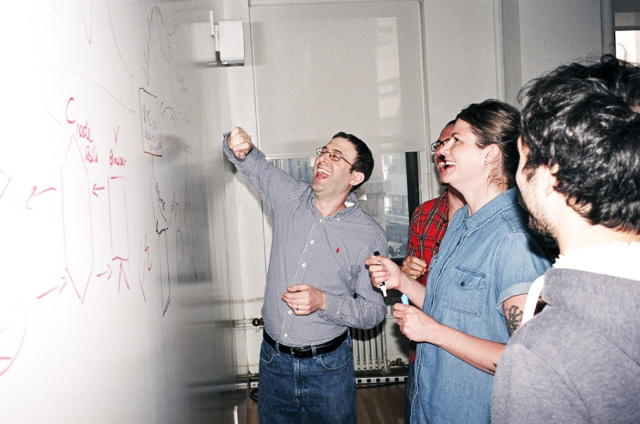

Welcome to General Assembly
WiFi GA Guest
Password yellowpencil
Notes:
[Leave this slide visible until presentation starts]

Slide 2

DATA SCIENCE
DAT11SYD
Lesson-08: Clustering

Slide 3
Course Plan
Paul & James review final project ideas

Slide 4
Git & GitHub – 1 Pager Guide!

Slide 5
AGENDA
Motivation / Review
What is Clustering?
What is K-Means and how does it work?
Lab
Discussion

Slide 6
WHAT IS CLUSTERING AND WHY DO IT?
DATA SCIENCE PART TIME COURSE

Slide 7
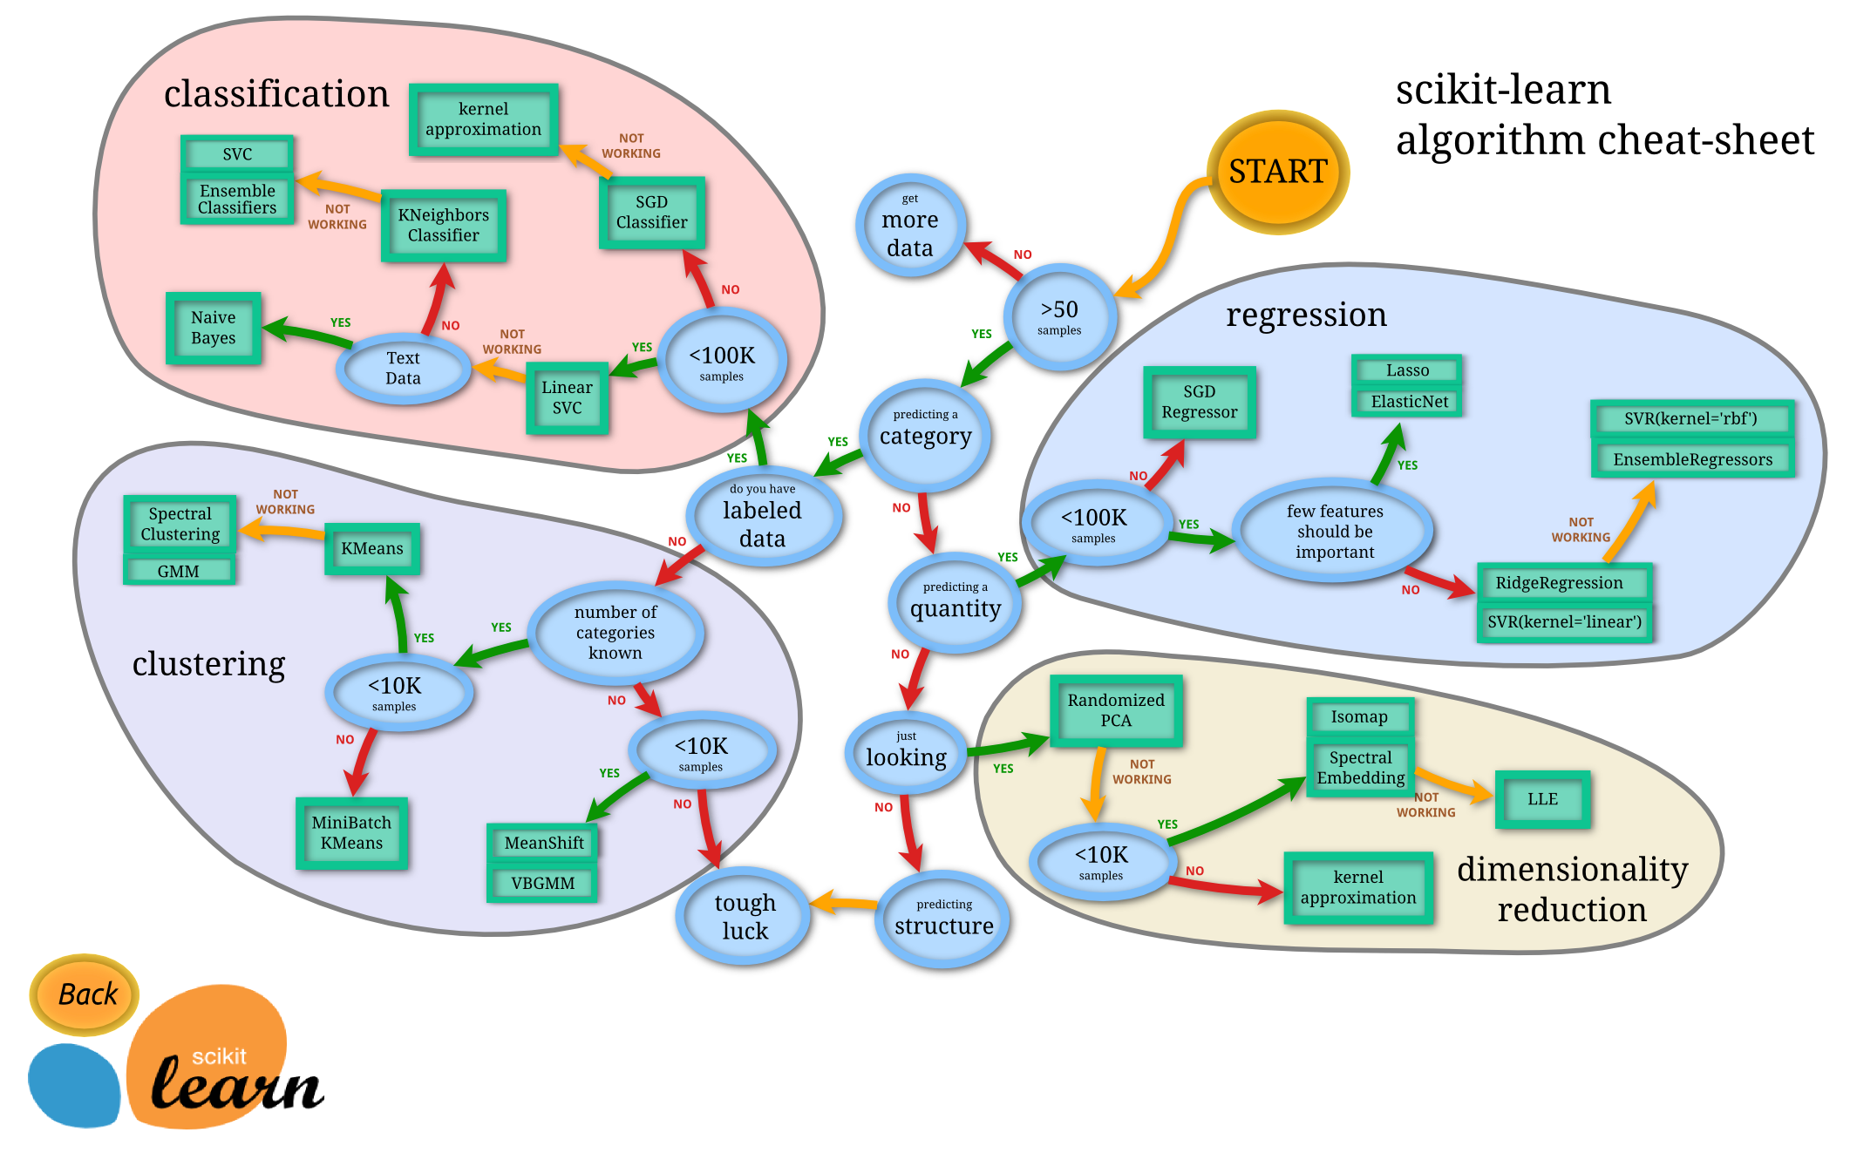

Slide 8
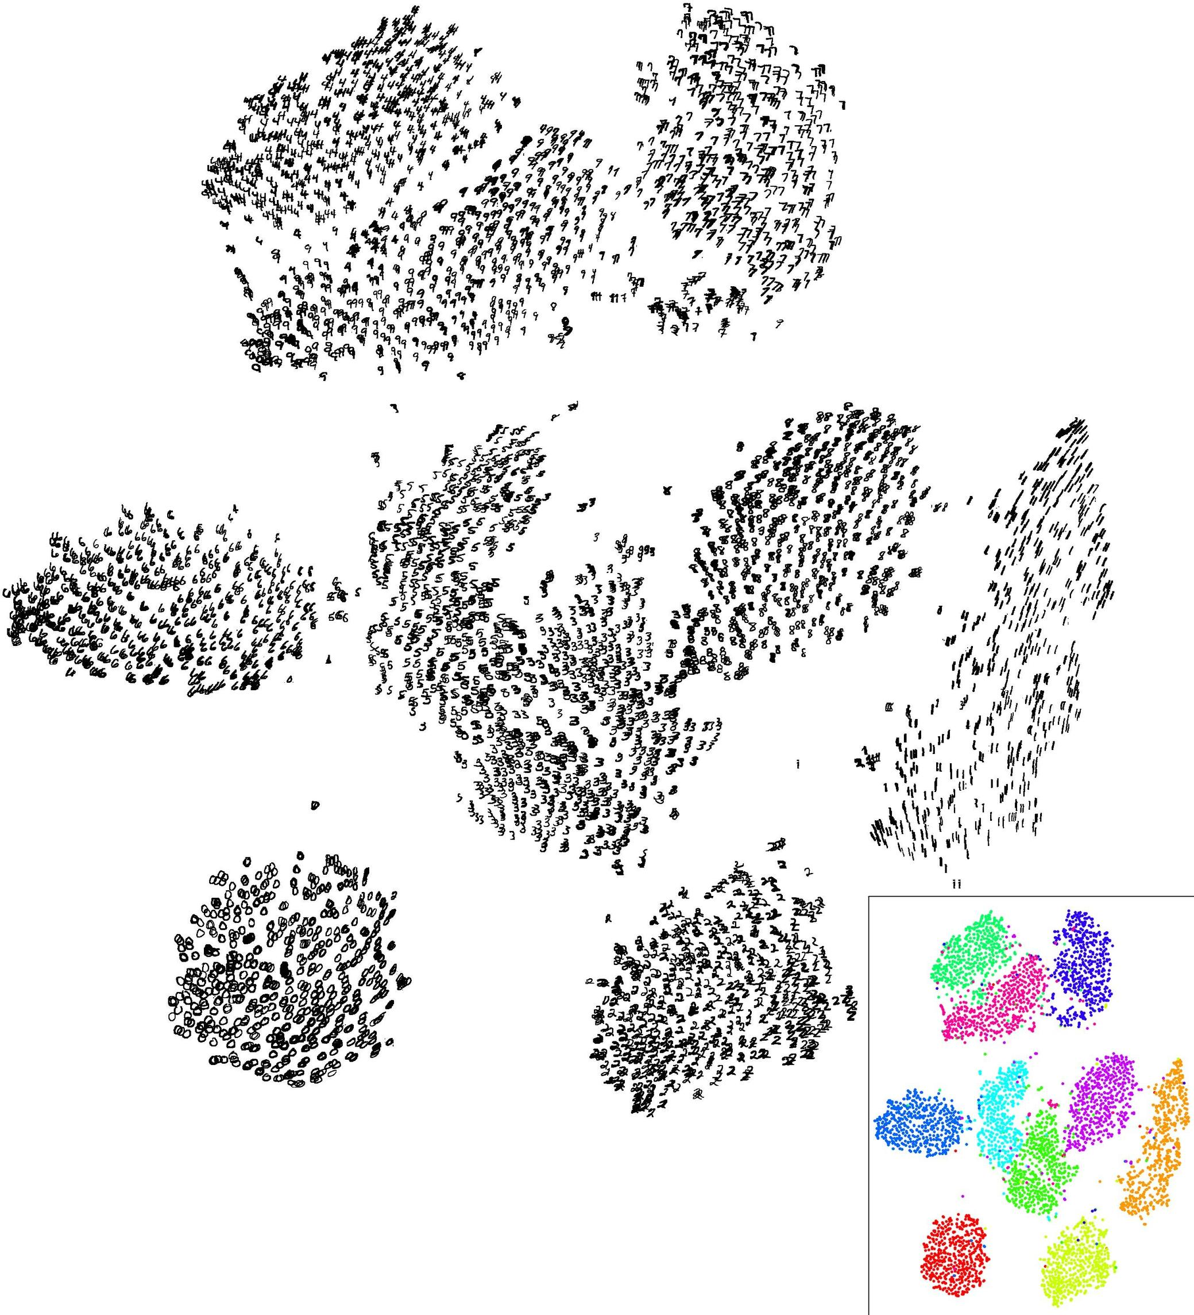
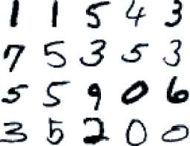
UNSUPERVISED LEARNING
MNIST

Slide 9
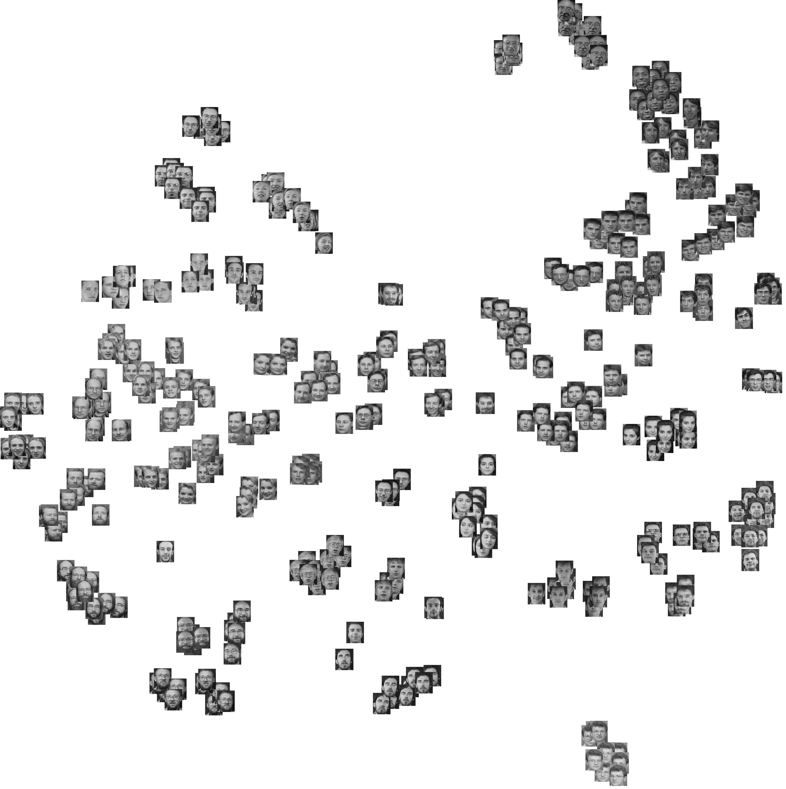
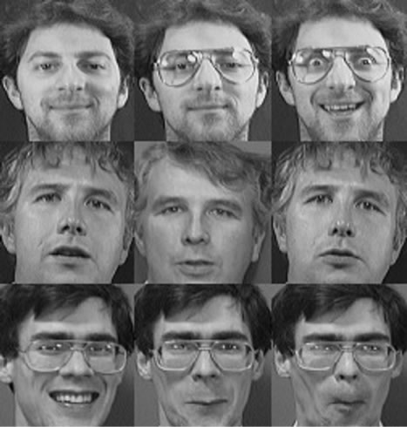
UNSUPERVISED LEARNING
Olivetti Faces

Slide 10
CLUSTERING
What is a Cluster?
Why would we do this?
What is K-Means?
x₁
x₂

Slide 11
WHAT IS A CLUSTER?
Unsupervised learning => find interesting patterns or groups in data.
No variable we are trying to predict (a Y value).
Clustering discovers subgroups in data where the points are similar to each other.
All points in the same group are similar.
Points in different groups are different to each other.
What variables to make groups on. What makes them different (or similar)?

Slide 12
WHY WOULD WE CLUSTER DATA?
To enhance understanding of a data by dividing into groups (behavioural customer segmentation).
Clustering provides a layer of abstraction from individual data points (cluster number).
The goal is to extract and enhance the natural structure of the data

Slide 13
WHY WOULD WE CLUSTER DATA?
Marketing teams might want to group customers into like groups as a way of summarising the data

Slide 14

WHY WOULD WE CLUSTER DATA?
Financial groups may want to group transactions into like groups as a way to find unusual payments

Slide 15
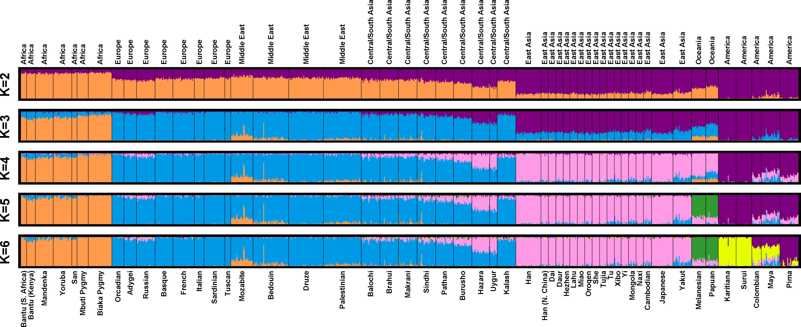
WHY WOULD WE CLUSTER DATA?
Genetics data can be clustered to identify ancestry

Slide 16
HOW DO WE CLUSTER DATA?
DATA SCIENCE PART TIME COURSE

Slide 17
KMEANS ALGORITHM
1) Choose k initial centroids (note that k is an input)
2) For each point:
- find distance to each centroid
- assign point to nearest centroid
3) Recalculate centroid positions
4) Repeat steps 2-3 until stopping criteria met

Slide 18
STEP 1 - CHOOSE CENTROIDS (Whiteboard)
There are several options:
- randomly (but may yield divergent behaviour)
- perform alternative clustering task, use resulting centroids as initial k-means centroids (warm start)
- start with global centroid, choose point at max distance, repeat (but might select outlier)

Slide 19
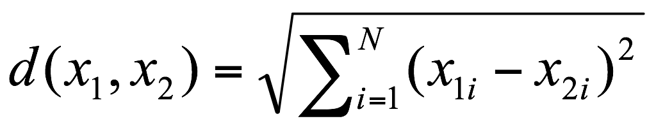

STEP 2 - ASSESS SIMILARITY
The similarity criterion is determined by the measure we choose.
In the case of k-means clustering, the similarity metric is the Euclidian distance:
Whiteboard distantce btwn 2 pts example

Slide 20
STEP 3 - RECALCULATE CENTROID POSITIONS
Q: How do we re-compute the positions of the centres at each iteration of the algorithm?

Slide 21
STEP 3 - RECALCULATE CENTROID POSITIONS
Q: How do we re-compute the positions of the centres at each iteration of the algorithm?
A: By calculating the centroid (i.e., the geometric centre)

Slide 22
STEP 4 - CONVERGENCE
We iterate until some stopping criteria are met; in general, suitable convergence is achieved in a small number of steps.
Stopping criteria can be based on the centroids (eg, if positions change by no more than ε) or on the points (eg, if no more than x% change clusters between iterations).

Slide 23
KMEANS ALGORITHM
1) Choose k initial centroids
2) For each point:
- find distance to each centroid
- assign point to nearest centroid
3) Recalculate centroid positions
4) Repeat steps 2-3 until stopping criteria met
x₁
x₂

Slide 24
KMEANS ALGORITHM
1) Choose k initial centroids
2) For each point:
- find distance to each centroid
- assign point to nearest centroid
3) Recalculate centroid positions
4) Repeat steps 2-3 until stopping criteria met
x₁
x₂

Slide 25
KMEANS ALGORITHM
1) Choose k initial centroids
2) For each point:
- find distance to each centroid
- assign point to nearest centroid
3) Recalculate centroid positions
4) Repeat steps 2-3 until stopping criteria met
x₁
x₂

Slide 26
KMEANS ALGORITHM
1) Choose k initial centroids
2) For each point:
- find distance to each centroid
- assign point to nearest centroid
3) Recalculate centroid positions
4) Repeat steps 2-3 until stopping criteria met
x₁
x₂

Slide 27
KMEANS ALGORITHM
1) Choose k initial centroids
2) For each point:
- find distance to each centroid
- assign point to nearest centroid
3) Recalculate centroid positions
4) Repeat steps 2-3 until stopping criteria met
x₁
x₂

Slide 28
KMEANS ALGORITHM
1) Choose k initial centroids
2) For each point:
- find distance to each centroid
- assign point to nearest centroid
3) Recalculate centroid positions
4) Repeat steps 2-3 until stopping criteria met
x₁
x₂

Slide 29
KMEANS ALGORITHM
1) Choose k initial centroids
2) For each point:
- find distance to each centroid
- assign point to nearest centroid
3) Recalculate centroid positions
4) Repeat steps 2-3 until stopping criteria met
x₁
x₂

Slide 30
KMEANS ALGORITHM
1) Choose k initial centroids
2) For each point:
- find distance to each centroid
- assign point to nearest centroid
3) Recalculate centroid positions
4) Repeat steps 2-3 until stopping criteria met
x₁
x₂

Slide 31
KMEANS ALGORITHM
1) Choose k initial centroids
2) For each point:
- find distance to each centroid
- assign point to nearest centroid
3) Recalculate centroid positions
4) Repeat steps 2-3 until stopping criteria met
x₁
x₂

Slide 32
KMEANS WEB DEMO
http://shabal.in/visuals/kmeans/1.html
Qn: How many clusters do you see?
The animation demonstrates the effects of different starting points on the clustering algorithm:
4 left-most points
4 right-most points
4 top-most points
4 bottom-most points

Slide 33
KMEANS WEB DEMO
http://shabal.in/visuals/kmeans/1.html
Using the 4 left-most points as the starting points:

Slide 34
KMEANS WEB DEMO
http://shabal.in/visuals/kmeans/1.html
Using the 4 right-most points as the starting points:

Slide 35
KMEANS WEB DEMO
http://shabal.in/visuals/kmeans/1.html
Using the 4 top-most points as the starting points:

Slide 36
KMEANS WEB DEMO
http://shabal.in/visuals/kmeans/1.html
Using the 4 bottom-most points as the starting points:

Slide 37
KMEANS WEB DEMO
Other good demos:
https://www.youtube.com/watch?v=mtkWR8sx0NA
https://www.youtube.com/watch?v=_aWzGGNrcic (especially from timestamp 4:22)
http://www.onmyphd.com/?p=k-means.clustering

Slide 38
OTHER CLUSTERING ALGORITHMS
DATA SCIENCE PART TIME COURSE

Slide 39
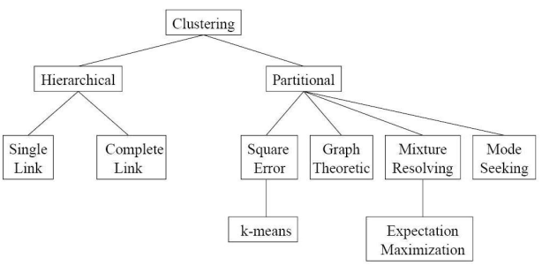
VARIETY OF CLUSTERING OPTIONS

Slide 40
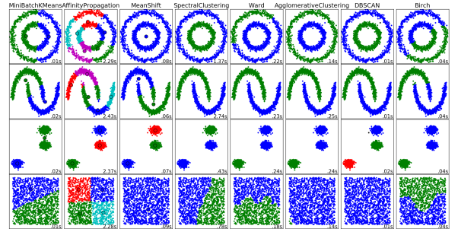
VARIETY OF CLUSTERING OPTIONS

Slide 41
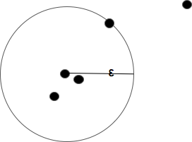
DBSCAN
Criteria
ε (or Epsilon) is the radius
minPoints (number of points within the ε-Neighborhood required for classification)
Note
DBSCAN iterates through every point
Core object (point meeting the criteria)
Outlier (outside the radius)
Density-Based Spatial Clustering of Applications with Noise (DBSCAN)

Slide 42
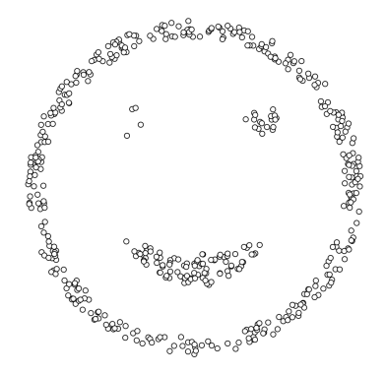
DBSCAN

Slide 43
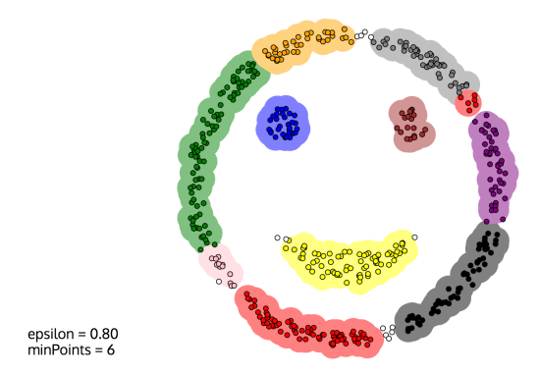
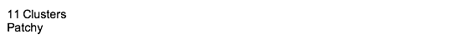
DBSCAN

Slide 44
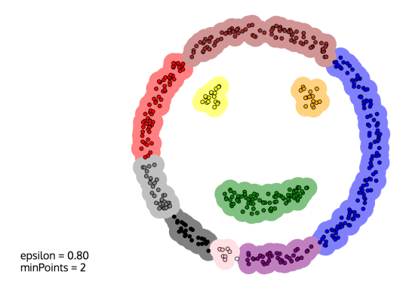
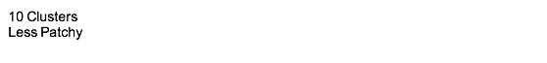
DBSCAN

Slide 45
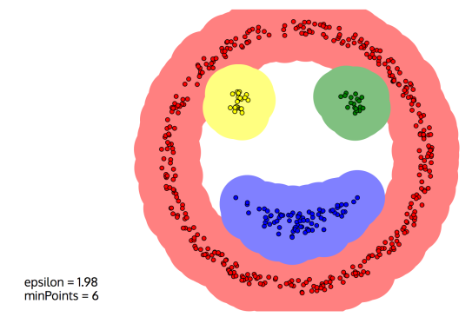
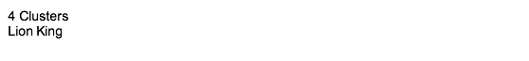

DBSCAN

Slide 46
DBSCAN
Pros
Recovers more complex cluster shapes
Finds the number of clusters
Automatically find outliers
Cons
Requires a distance function
Not as scalable as K-means
Calculating connected components can be difficult

Slide 47
HOW DO WE KNOW OUR CLUSTERS ARE ANY GOOD?
DATA SCIENCE PART TIME COURSE

Slide 48
CLUSTER VALIDATION
In general, k-means will converge to a solution and return a partition of k clusters, even if no natural clusters exist in the data.
We will look at two validation metrics useful for partitional clustering, cohesion and separation.

Slide 49
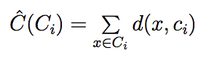
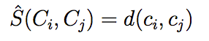
CLUSTER VALIDATION
Cohesion measures clustering effectiveness within a cluster.
Separation measures clustering effectiveness between clusters.

Slide 50
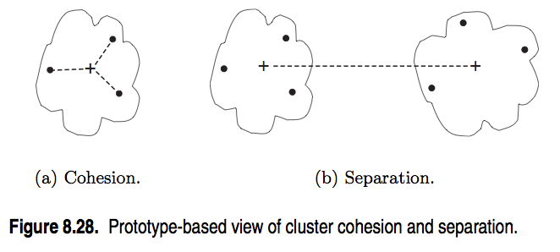
CLUSTER VALIDATION
source: http://www-users.cs.umn.edu/~kumar/dmbook/ch8.pdf

Slide 51
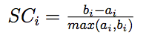
CLUSTER VALIDATION
A useful measure that combines the ideas of cohesion and separation is the silhouette coefficient. For point xi, this is given by:
such that:
ai = average intra-cluster distance to xi
bij = average extra-cluster distance to xi
bi = minj(bij)
ai
bi2
xi
bi1

Slide 52
CLUSTER VALIDATION
The silhouette coefficient can take values between -1 and 1.
In general, we want separation to be high and cohesion to be low. This corresponds to a value of SC close to +1.
A negative silhouette coefficient means the cluster radius is larger than the space between clusters, and thus clusters overlap

Slide 53
CLUSTER VALIDATION
One useful application of cluster validation is to determine the best number of clusters for your dataset.
Q: How would you do this?

Slide 54
CLUSTER VALIDATION
One useful application of cluster validation is to determine the best number of clusters for your dataset.
Q: How would you do this?
A: By computing the Silhouette Coefficient for different values of k.

Slide 55
CLUSTER VALIDATION
Ultimately, cluster validation and clustering in general are subjective techniques that rely on human interpretation to be meaningful.

Slide 56
CLUSTER VALIDATION
Art

Slide 57
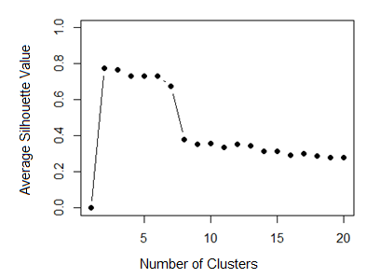
CLUSTER VALIDATION

Slide 58
CLUSTER VALIDATION
Strengths:
K-means is a popular algorithm because of its computational efficiency and simple and intuitive nature.
Weaknesses:
However, K-means is highly scale dependent, and is not suitable for data with widely varying shapes and densities.

Slide 59
LAB
DATA SCIENCE PART TIME COURSE

Slide 60
HOMEWORK
Read the following
Chapter 10.3 of Introduction to Statistical Learning - Clustering Methods in Introduction to Statistical Learning (15 pages)
DATA SCIENCE
…OR…

Slide 61
HOMEWORK
PCA: https://youtu.be/Zbr5hyJNGCs, https://www.youtube.com/watch?v=cnCzY5M3txk
Clustering (Siraj Raval): https://youtu.be/9991JlKnFmk
Python Notebook on Clustering => link
Pre Reading:
http://www.slideshare.net/MrChrisJohnson/algorithmic-music-recommendations-at-spotify
http://techblog.netflix.com/2012/04/netflix-recommendations-beyond-5-stars.html
DATA SCIENCE - Week 4 Day 1

